Slide 1
FACE MASK DETECTION
06.12.2020
Yushan Wang
Jiemin Tang
COGS 181
By using Convolutional Neural Network

Slide 2
Overview
Project description
Background
Overall workflow
Intro to datasets
Methodology and key concepts
Face detection
CNN and VGG 16
Experiments
CNN Classifier training
VGG-16 result
Testing
Live-stream model testing
Conclusion
Future improvements

Slide 3
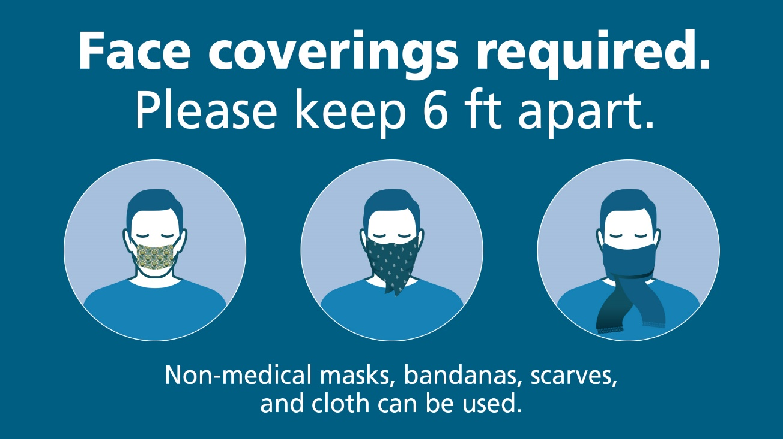
Project Description
Background
Objective
COVID-19
FACE COVERING
Create a model could be used in live stream video to detect faces in the video and predict whether wearing masks or not.

Slide 4
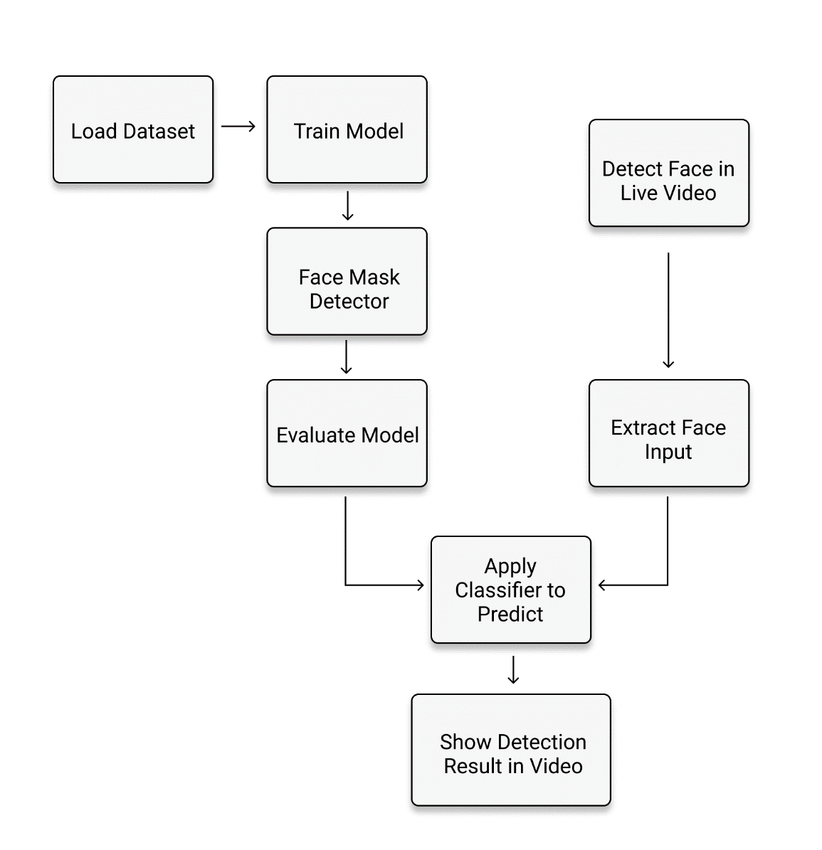
Project Description
Overall Workflow
Model for face detection
Model for mask or not mask prediction

Slide 5
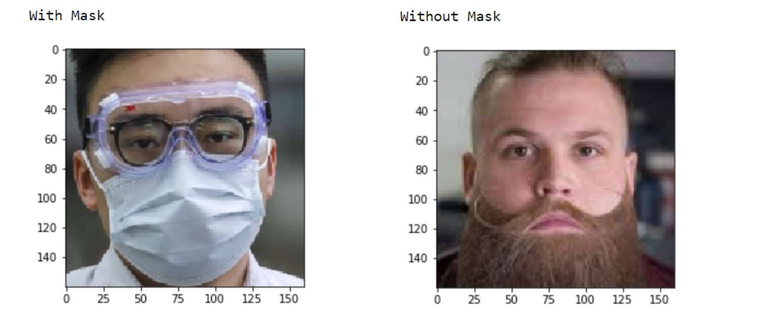
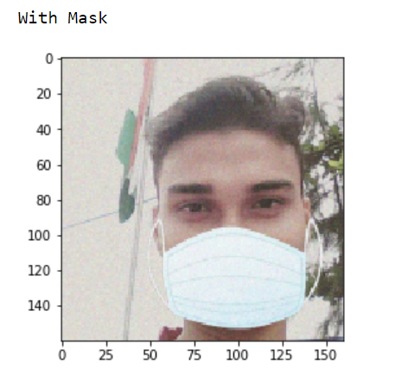
Project Description
Intro to datasets
If no mask then generate a mask
Auto-generated masks
Refer to “Prajna Bhandary for the auto-generated mask dataset”
Mask no mask

Slide 6
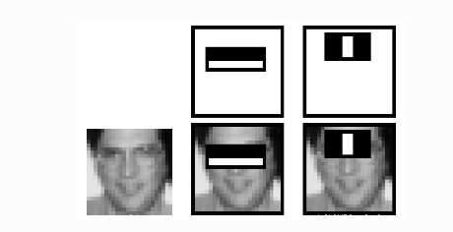
Key Concepts / Methodology
Face Detection
Haar Cascade
Using pre-trained model in openCV
OpenCV tutorial: https://www.youtube.com/watch?v=88HdqNDQsEk
Notes:
Here we will work with face detection. Initially, the algorithm needs a lot of positive images (images of faces) and negative images (images without faces) to train the classifier. Then we need to extract features from it. For this, haar features shown in below image are used. They are just like our convolutional kernel. Each feature is a single value obtained by subtracting sum of pixels under white rectangle from sum of pixels under black rectangle.
For this, we apply each and every feature on all the training images. For each feature, it finds the best threshold which will classify the faces to positive and negative. But obviously, there will be errors or misclassifications. We select the features with minimum error rate, which means they are the features that best classifies the face and non-face images. (The process is not as simple as this. Each image is given an equal weight in the beginning. After each classification, weights of misclassified images are increased. Then again same process is done. New error rates are calculated. Also new weights. The process is continued until required accuracy or error rate is achieved or required number of features are found).

Slide 7
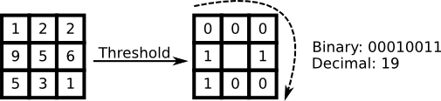
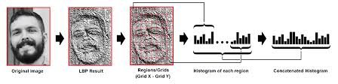
Key Concepts / Methodology
Face Detection
Local Binary Pattern
Using pre-trained model in openCV

Slide 8
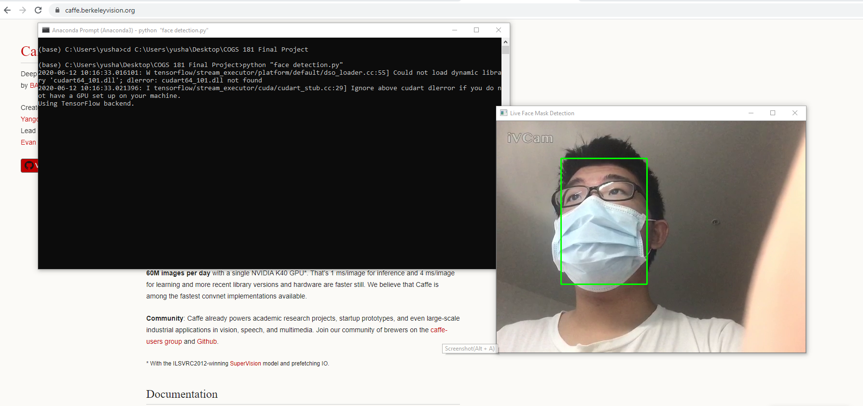
Key Concepts / Methodology
CAFFE-DNN
LBP and Haar would be less effective when mask is wearing
https://caffe.berkeleyvision.org/
The .prototxt file(s) which define the model architecture (i.e., the layers themselves)
The .caffemodel file which contains the weights for the actual layers
Face Detection
Demonstration
Notes:
Caffe is a deep learning framework made with expression, speed, and modularity in mind. It is developed by Berkeley AI Research (BAIR) and by community contributors. Yangqing Jia created the project during his PhD at UC Berkeley. Caffe is released under the BSD 2-Clause license.

Slide 9

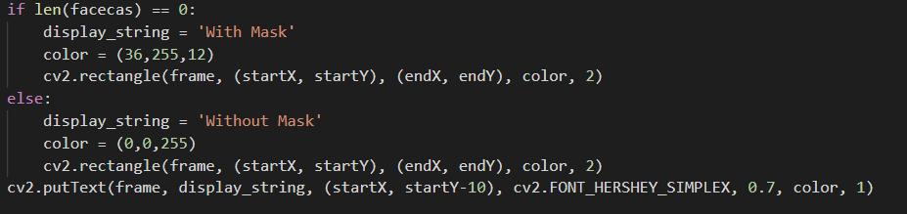
Mask Detection
Haar cannot detect face when wearing mask.
Caffe-dnn can detect face when wearing mask
When both model detect face
When haar detect no face and caffe detect face
Without_mask
With_mask

Slide 10
Mask Detection
MORE THAN ONE FACE? DEAD
Haar cannot detect face when wearing mask.
Caffe-dnn can detect face when wearing mask
When both model detect face
When haar detect no face and caffe detect face
Without_mask
With_mask

Slide 11
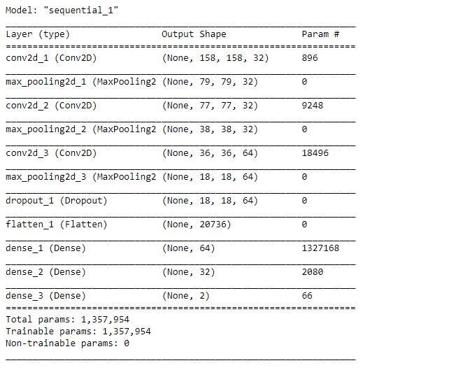
Mask Detection CNN and VGG-16
Image classification
Model for mask or not mask prediction
Binary image classification CNN
MODEL FOR “cat-dog” classification

Slide 12
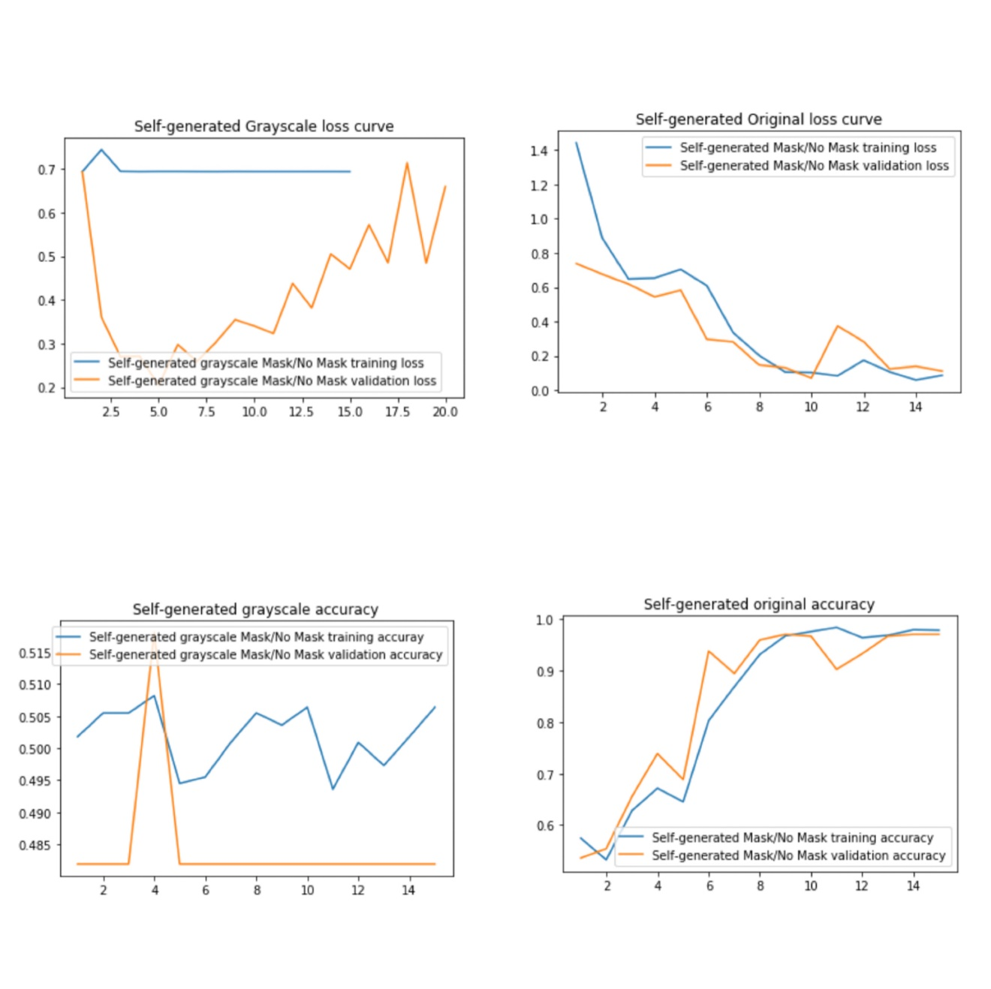
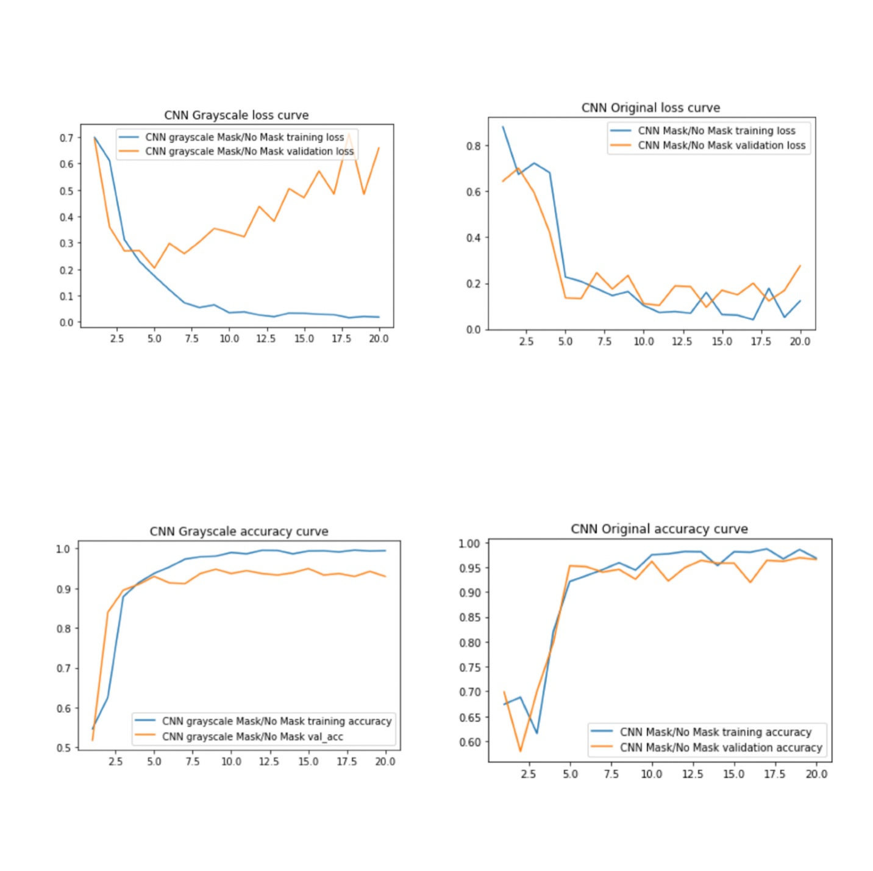
Mask Detection CNN and VGG-16
Generated-mask dataset
when wearing mask.
Mask_no_mask datasetwhen wearing mask.

Slide 13
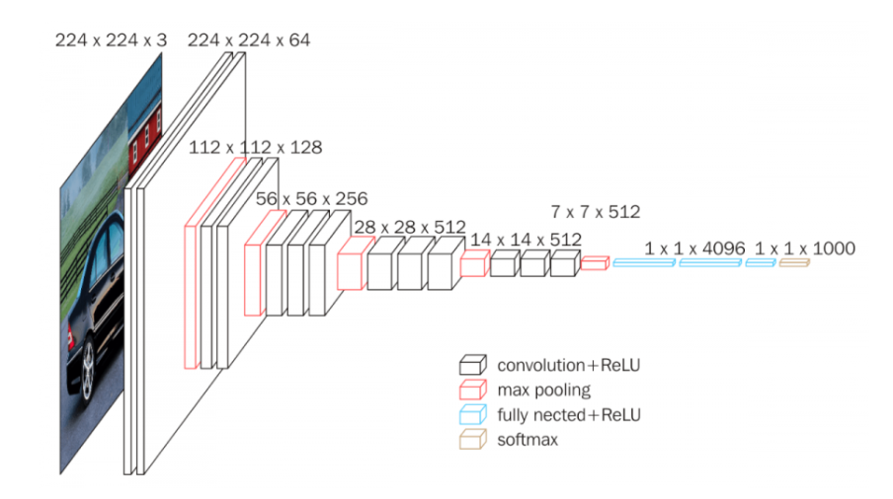
VGG-16
VERY DEEP CONVOLUTIONAL NETWORKS FOR LARGE-SCALE IMAGE RECOGNITION Karen Simonyan ∗ & Andrew Zisserman
Karen Simonyan ∗ & Andrew Zisserman

Slide 14
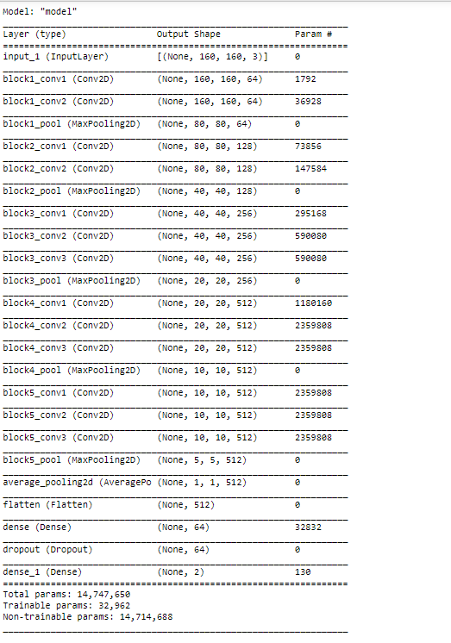
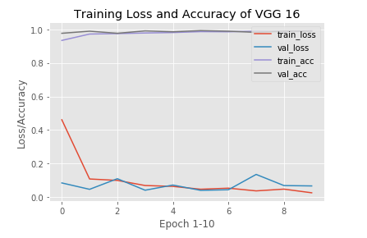
VGG-16

Slide 15
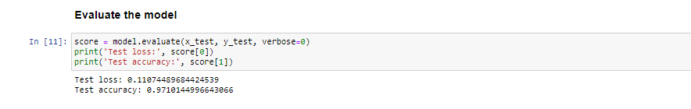
Testing
CNN
VGG-16

Slide 16
Testing
CNN
VGG-16

Slide 17
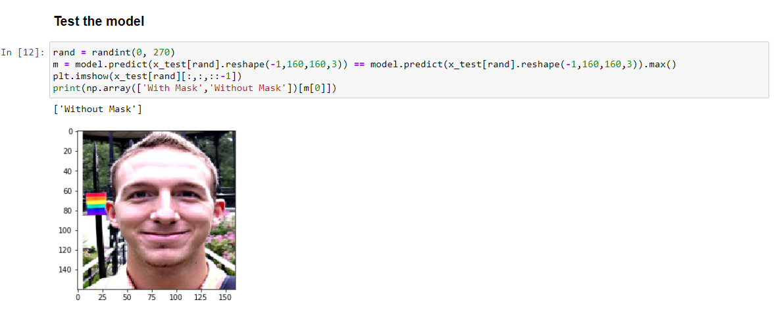
Testing
Run number | Description | Result A | Result B
1 | Condition A | True | True
2 | Condition B | True | False
3 | Condition C | False | False

Slide 18
Live-stream model testing

Slide 19
Conclusion
Mask classifier design OK
Application Status
Could work
For CCTV camera might need more testing with lower resolution video and image
Future Improvements
Testing with more people in the same frame
Testing with low-resolution video footage
Better visualization

Slide 20
Questions & Discussion

